Slide 1
PARTS AND TYPES OF TREES FOR EDUCATION INFOGRAPHICS
Here is where this template begins

Slide 2
PARTS AND TYPES OF TREES FOR EDUCATION INFOGRAPHICS
This template contains an assortment of complementary infographic resources for the Parts & Types of Trees for Education presentation.
These infographics are adapted to the style of the aforementioned presentation, so you can insert them easily and have them completely integrated at once. You just need to do the following:
  Select the element that you want to copy
  Right-click and choose “Copy”
  Go to the slide where you want the element to appear
  Right-click and choose “Paste”

Slide 3
PARTS AND TYPES OF TREES FOR EDUCATION INFOGRAPHICS
01
02
LEAVES
BRANCHES
Saturn is composed of hydrogen and helium
Despite being red, Mars is a cold place
03
04
ROOTS
TRUNK
Neptune is the farthest planet from the Sun
Mercury is the closest planet to the Sun

Slide 4
PARTS AND TYPES OF TREES FOR EDUCATION INFOGRAPHICS
TYPES OF LEAVES
SIMPLE
COMPOUND
LOBED
LOBED
PINNATE
FASCICLE
ENTIRE
TRIFOLIATE

Slide 5
PARTS AND TYPES OF TREES FOR EDUCATION INFOGRAPHICS
MAPLE
Saturn is composed of hydrogen and helium
POPLAR
Despite being red, Mars is a cold place
SPRUCE
Mercury is the closest planet to the Sun
WILLOW
Jupiter is a gas giant and the biggest planet
PALM
Neptune is the farthest planet from the Sun

Slide 6
PARTS AND TYPES OF TREES FOR EDUCATION INFOGRAPHICS
TYPES OF TREES IN THE WORLD
50%
50%
EVERGREEN
DECIDUOUS
Venus has a beautiful name and is the second planet from the Sun. It’s terribly hot
Saturn is a gas giant and has several rings. It's composed mostly of hydrogen and helium

Slide 7
PARTS AND TYPES OF TREES FOR EDUCATION INFOGRAPHICS
MOON
JUPITER
SATURN
NEPTUNE
SIMPLE
COMPOUND
The Moon is Earth’s only natural satellite
It’s the biggest planet in the Solar System
Saturn is a gas giant and has rings
It’s the farthest planet from the Sun
Mercury is the closest planet to the Sun
Despite being red, Mars is a cold place
TYPES OF LEAVES

Slide 8
PARTS AND TYPES OF TREES FOR EDUCATION INFOGRAPHICS
CHECK THE TYPE OF TREE AND THE SEASON IN WHICH IT BLOOMS
 | DESCRIPTION | SUMMER | SPRING | WINTER
WILLOW | We all live on Earth
PALM | Jupiter is a gas giant
OAK | Saturn has rings
MAPLE | Venus is very hot

Slide 9
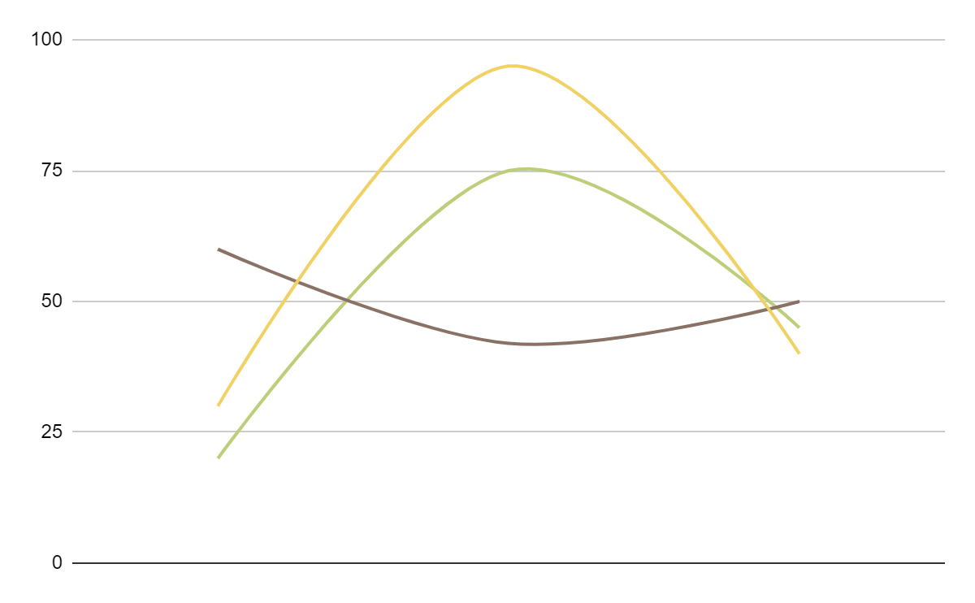
PARTS AND TYPES OF TREES FOR EDUCATION INFOGRAPHICS
EVOLUTION OF TREES IN THE WORLD
SATURN
Saturn is composed of hydrogen and helium
MARS
Despite being red, Mars is a cold place
NEPTUNE
Neptune is the farthest planet from the Sun
1980
2000
2020
Follow the link in the graph to modify its data and then paste the new one here. For more info, click here

Slide 10
PARTS AND TYPES OF TREES FOR EDUCATION INFOGRAPHICS
MAPLE
Despite being red, Mars is a cold place
POPLAR
Saturn is composed of hydrogen and helium
WILLOW
Mercury is the closest planet to the Sun

Slide 11
PARTS AND TYPES OF TREES FOR EDUCATION INFOGRAPHICS
TREES IN THE WORLD ACCORDING TO THEIR FRUIT
EARTH
Earth is the third planet from the Sun
45%
NEPTUNE
Neptune is the farthest planet from the Sun
25%
MERCURY
30%
Mercury is the closest planet to the Sun

Slide 12
PARTS AND TYPES OF TREES FOR EDUCATION INFOGRAPHICS
TREE OBSERVATION CARD
 | CHANGE | NOTES
JANUARY | We all live on Earth | Earth
MARCH | Mars is a cold planet | Mars
JUNE | Jupiter is a gas giant | Jupiter
AUGUST | Mercury is very small | Mercury
OCTOBER | Saturn has rings | Saturn
DECEMBER | Venus is very hot | Venus
POPLAR

Slide 13
PARTS AND TYPES OF TREES FOR EDUCATION INFOGRAPHICS
TREES IN DANGER OF EXTINCTION:
DEFORESTATION PERCENTAGES DURING LAST YEAR
70%
40%
35%
90%
NEPTUNE
MARS
MERCURY
EARTH
Neptune is the farthest planet from the Sun
Despite being red, Mars is a cold place
Mercury is the closest planet to the Sun
Earth is the third planet from the Sun

Slide 14
PARTS AND TYPES OF TREES FOR EDUCATION INFOGRAPHICS
SUMMER
AUTUMN
Despite being red, Mars is a cold place
Mercury is the closest planet to the Sun
SPRING
WINTER
Neptune is the farthest planet from the Sun
Earth is the third planet from the Sun

Slide 15
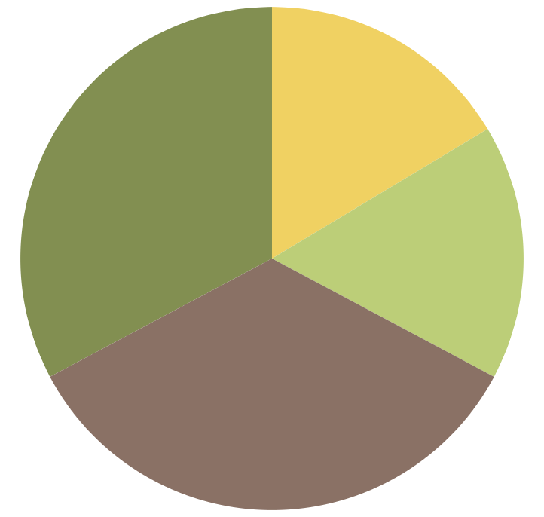
PARTS AND TYPES OF TREES FOR EDUCATION INFOGRAPHICS
TREES IN THE WORLD ACCORDING TO THEIR TYPE OF LEAVES
SATURN 30%
MARS 15%
Saturn is composed of hydrogen and helium
Despite being red, Mars is a cold place
NEPTUNE 35%
MERCURY 20%
Neptune is the farthest planet from the Sun
Mercury is the closest planet to the Sun
Follow the link in the graph to modify its data and then paste the new one here. For more info, click here

Slide 16
PARTS AND TYPES OF TREES FOR EDUCATION INFOGRAPHICS
DIFFERENCES BETWEEN TREES
SATURN
EARTH
MARS
JUPITER
Saturn is composed of hydrogen and helium
Earth is the third planet from the Sun
Despite being red,
Mars is a cold place
Jupiter is a gas giant
and the biggest planet

Slide 17
PARTS AND TYPES OF TREES FOR EDUCATION INFOGRAPHICS
FEATURES OF TRUNKS
CORTEX | Mars | Venus | Saturn | Jupiter
HARDNESS | Medium | High | Low | High
MALLEABILITY | Low | Low | High | Medium

Slide 18
PARTS AND TYPES OF TREES FOR EDUCATION INFOGRAPHICS
EVOLUTION OF THE GROWTH OF A TREE
NEPTUNE
SATURN
MARS
MERCURY
EARTH
Neptune is the farthest planet from the Sun
It’s composed of hydrogen and helium
Despite being red, Mars is a cold place
Mercury is the closest planet to the Sun
Earth is the third planet from the Sun

Slide 19
PARTS AND TYPES OF TREES FOR EDUCATION INFOGRAPHICS
PARTS OF A TRUNK
Saturn is composed of hydrogen and helium
CORTEX
Despite being red, Mars is a cold place
CAMBIUM
Mercury is the closest planet to the Sun
SAPWOOD
Jupiter is a gas giant and the biggest planet
HEARTWOOD
Pluto is now considered a dwarf planet
CORE

Slide 20
PARTS AND TYPES OF TREES FOR EDUCATION INFOGRAPHICS
MOST COMMON TREES ACCORDING TO THE CONTINENT
 | EUROPE | ASIA | NORTH AMERICA | SOUTH AMERICA | AFRICA | AUSTRALIA
EVERGREEN
DECIDUOUS

Slide 21
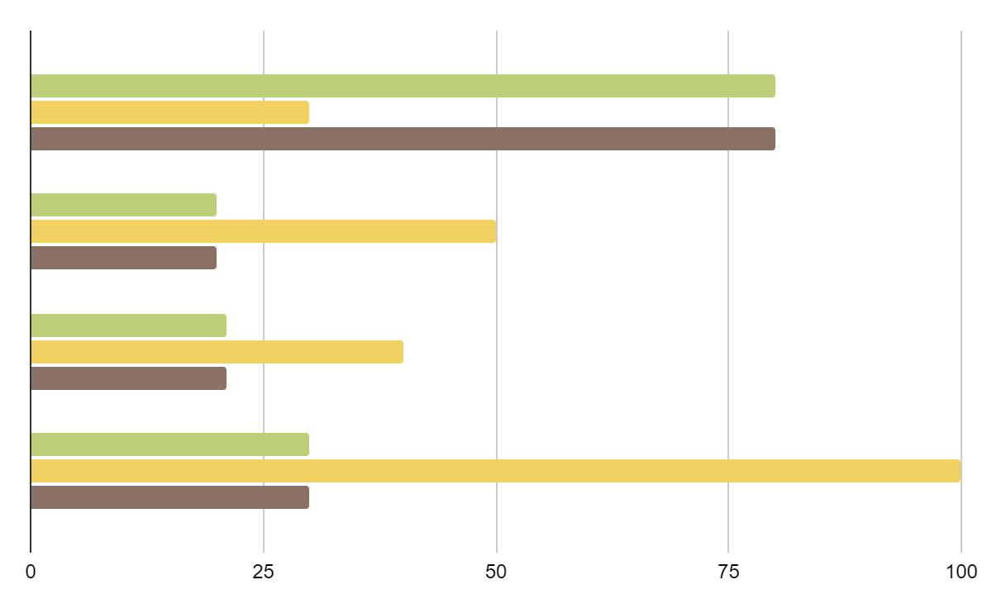
PARTS AND TYPES OF TREES FOR EDUCATION INFOGRAPHICS
NUMBER OF TREES ACCORDING TO THE SEASON
MARS
WINTER
Despite being red, Mars is a cold place
FALL
SATURN
Saturn is composed of hydrogen and helium
SUMMER
MERCURY
SPRING
Mercury is the closest planet to the Sun
Follow the link in the graph to modify its data and then paste the new one here. For more info, click here

Slide 22
PARTS AND TYPES OF TREES FOR EDUCATION INFOGRAPHICS
DIFFERENCES IN THE GROWTH OF THESE TREES
MARS
MERCURY
EARTH
Despite being red, Mars is a cold place
Mercury is the closest planet to the Sun
Earth is the third planet from the Sun

Slide 23
PARTS AND TYPES OF TREES FOR EDUCATION INFOGRAPHICS
EVERGREEN
Saturn is composed of hydrogen and helium
DECIDUOUS
Mercury is the closest planet to the Sun

Slide 24
PARTS AND TYPES OF TREES FOR EDUCATION INFOGRAPHICS
LONGEST LIVING TREES ON EARTH
SATURN
200
Saturn is composed of hydrogen and helium
MARS
500
Despite being red, Mars is a cold place
MERCURY
1,000
Mercury is the closest planet to the Sun
JUPITER
1,500
Jupiter is a gas giant and the biggest planet

Slide 25
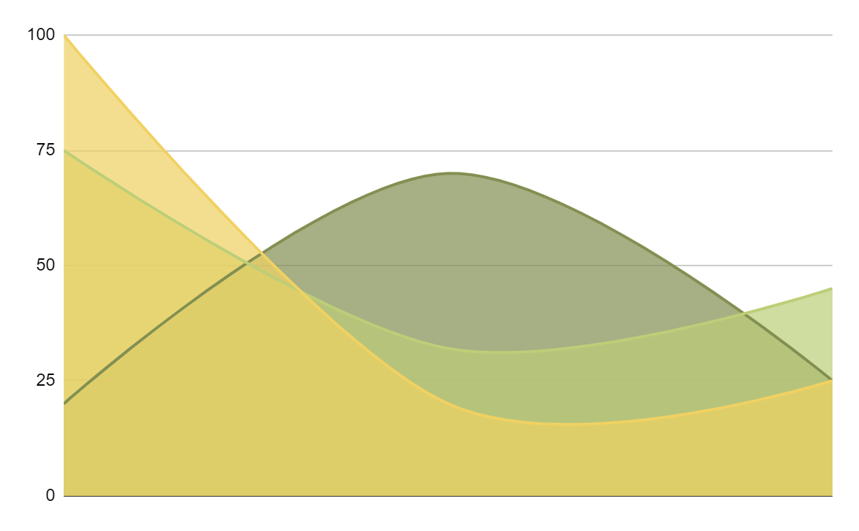
PARTS AND TYPES OF TREES FOR EDUCATION INFOGRAPHICS
HUMIDITY NECESSARY FOR THE DEVELOPMENT OF THESE TREES
MARS
Despite being red, Mars is a cold place
SATURN
Saturn is composed of hydrogen and helium
MERCURY
Mercury is the closest planet to the Sun
Follow the link in the graph to modify its data and then paste the new one here. For more info, click here

Slide 26
PARTS AND TYPES OF TREES FOR EDUCATION INFOGRAPHICS
NAME | Poplar | Baobab | Maple
FEATURES | Despite being red, Mars is a cold place | Mercury is the closest planet to the Sun | The Moon is Earth’s only natural satellite
CONTINENT | North America | Asia | Europe
TYPE OF LEAF | Evergreen | Deciduous | Evergreen

